Slide 1
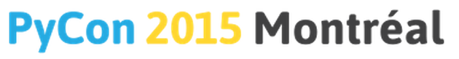
Programming for Everybody in Python
Charles Severance @drchuck
Python Education Summit
9-April-2015
www.slideshare.net/csev
www.dr-chuck.com
Notes:
Total students: 363K, paid 3325 1/10 finished 1/100 paid 150K students 1486 books wholesale for my book $3.82

Slide 2
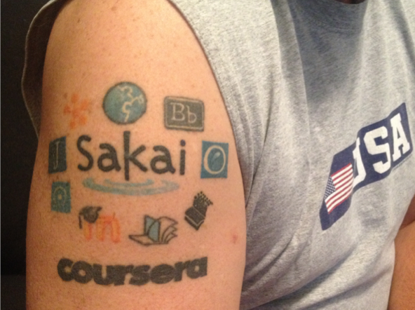
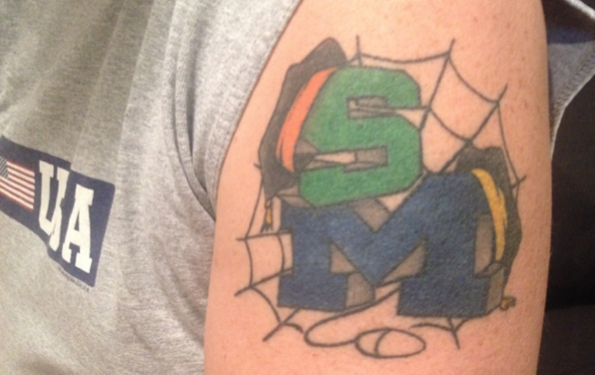
Tattoos
Research
Education / Teaching

Slide 3
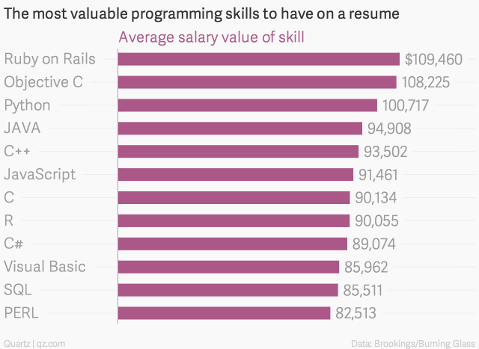
http://qz.com/298635/these-programming-languages-will-earn-you-the-most-money/

Slide 4
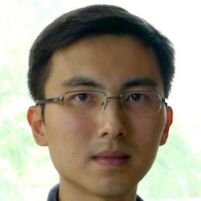
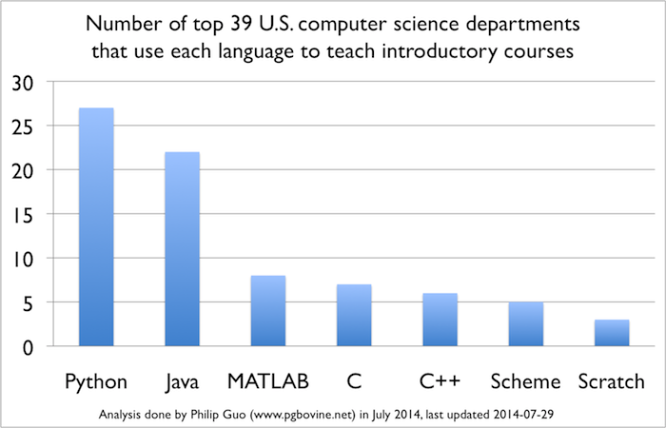
www.pythontutor.com
Phillip Guo
University of Rochester
www.pgbovine.net
www.pythontutor.com
Python is Now the Most Popular Introductory Teaching Language at Top U.S. Universities, Philip Guo, July 7, 2014
http://cacm.acm.org/blogs/blog-cacm/176450-python-is-now-the-most-popular-introductory-teaching-language-at-top-us-universities/fulltext
Notes:
University of Rochester

Slide 5
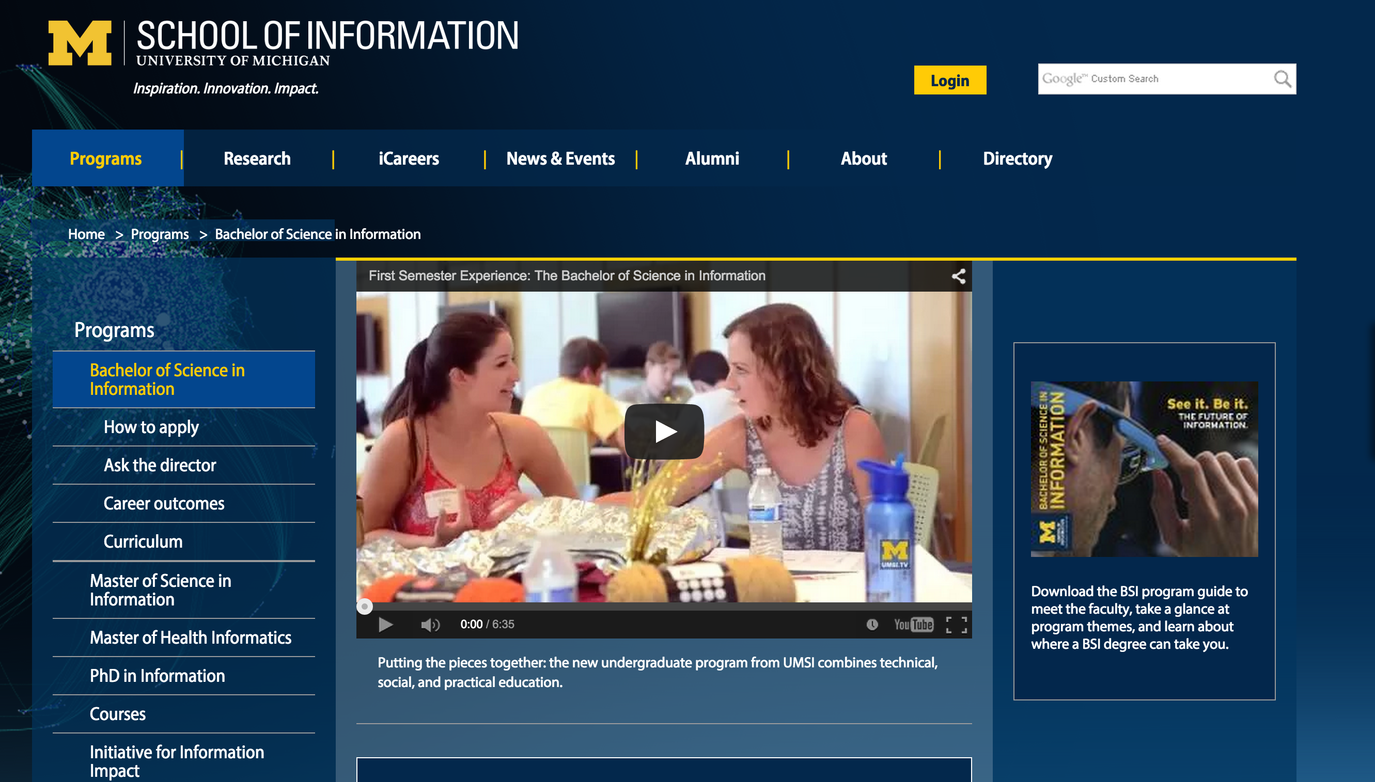
Python, R, JavaScript, Java, PHP, SQL, Swift, ObjectiveC. Statistics, Visualization, Economics, Game Theory, Motivation, Network Analysis, Data Mining...
Notes:
Evaluation, Design and Implementing Technology systems BSI, Python, R, JavaScript, Java, PHP, SQL, Swift, ObjectiveC. Statistics, Visualization, Economics, Game Theory, Motivation, Network Analysis.

Slide 6
Python, R, JavaScript, Java, PHP, SQL, Swift. Statistics, Visualization, Economics, Game Theory, Motivation, Network Analysis, Data Mining, Design, Evaluation ...
Notes:
2015 – 57% women

Slide 7
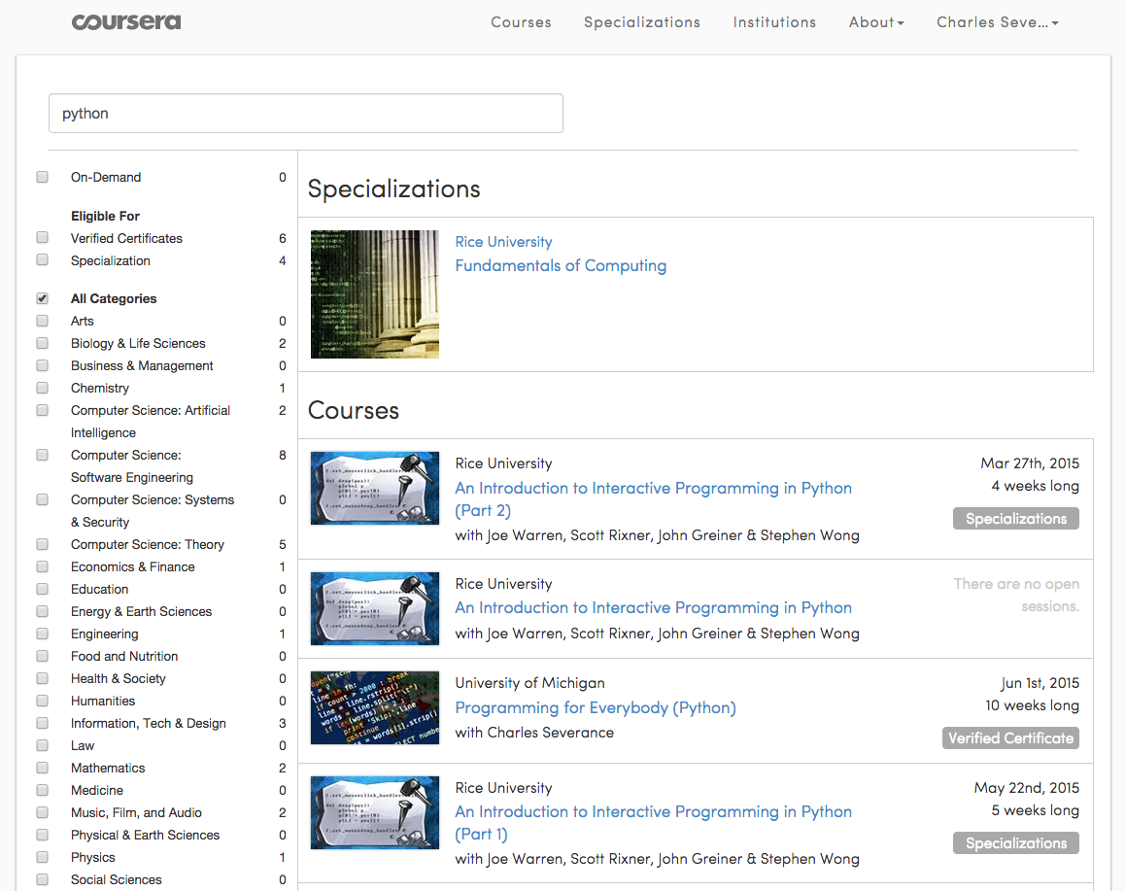
>12 Million Students
Notes:
Top search query on Coursera is "Python" The top-10 are mostly programming relatted

Slide 8
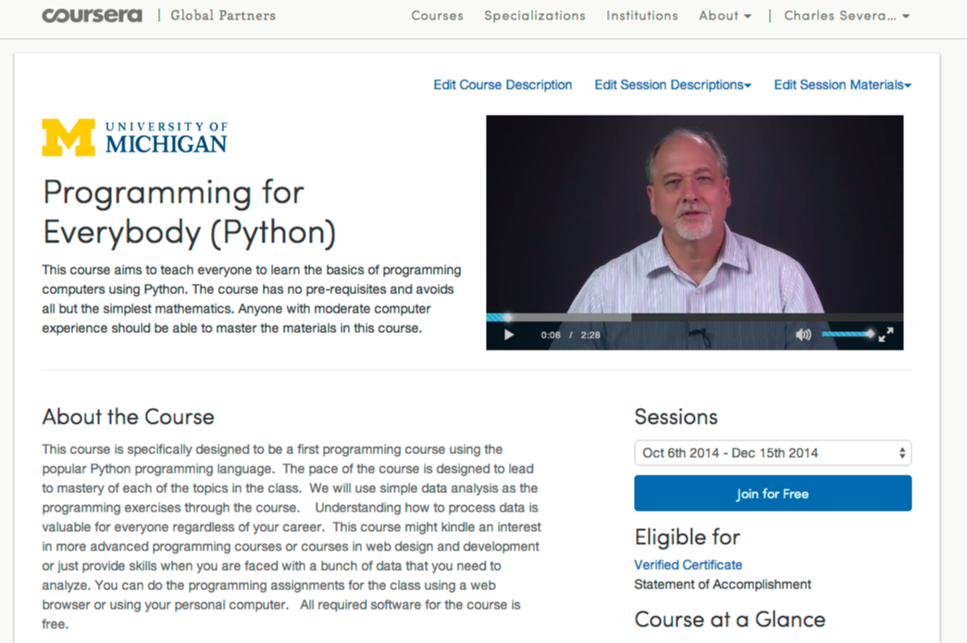

Slide 9
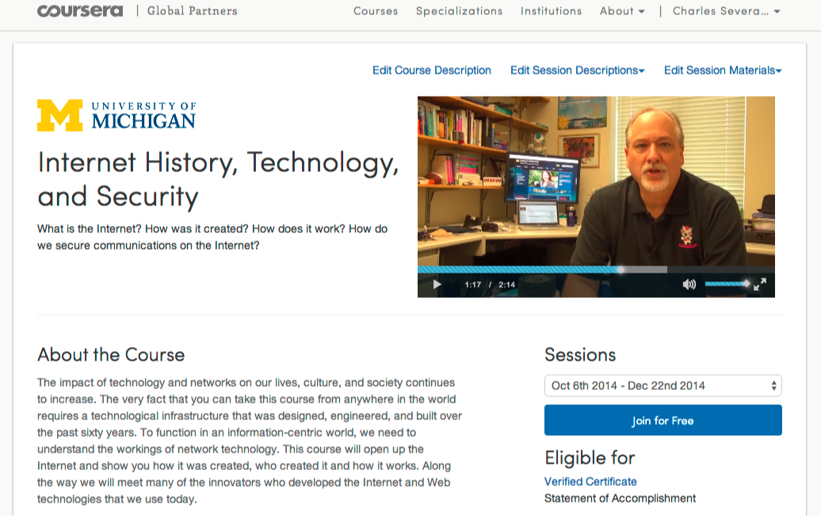

Slide 10
562,767 Total Enrollment
> 350K Revenue
27K Certs in 2014
Notes:
1/3 Women – Teaching at 150K is different than teaching at 20K

Slide 11
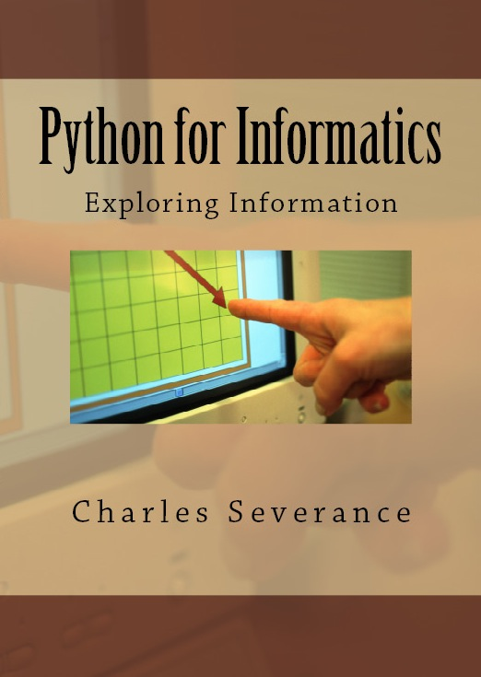
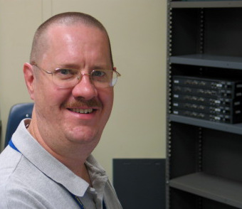
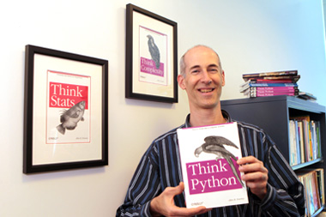
Free Book Revenue
www.pythonlearn.com

Slide 12
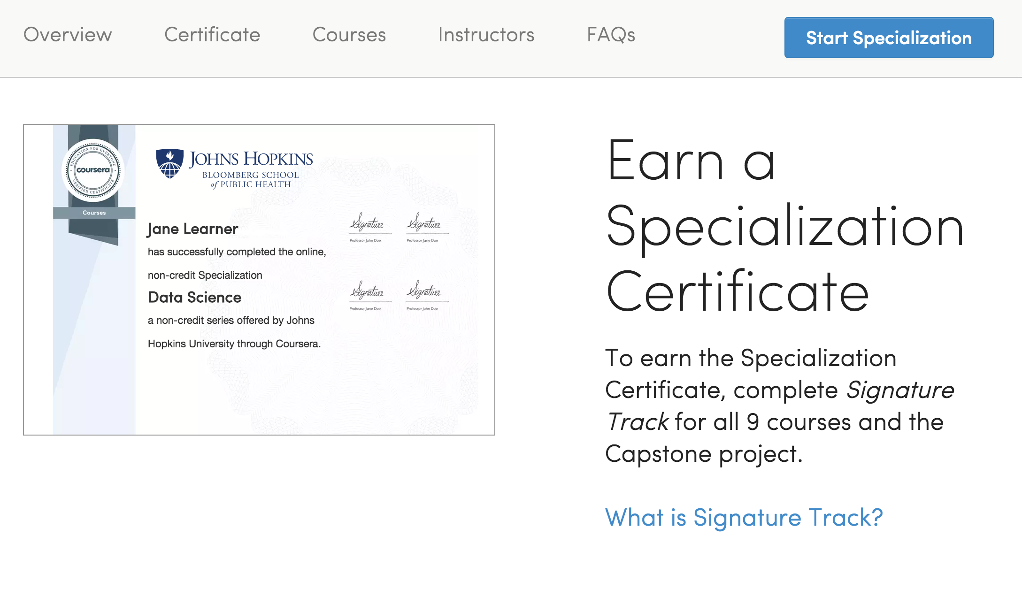
Notes:
$3.5M

Slide 13
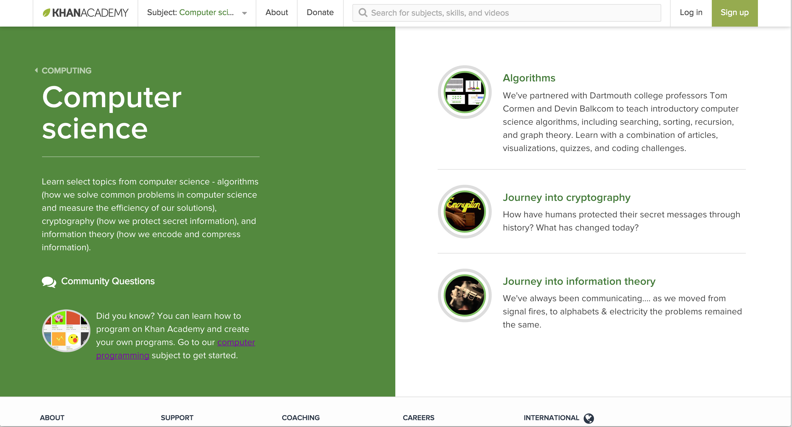

Slide 14
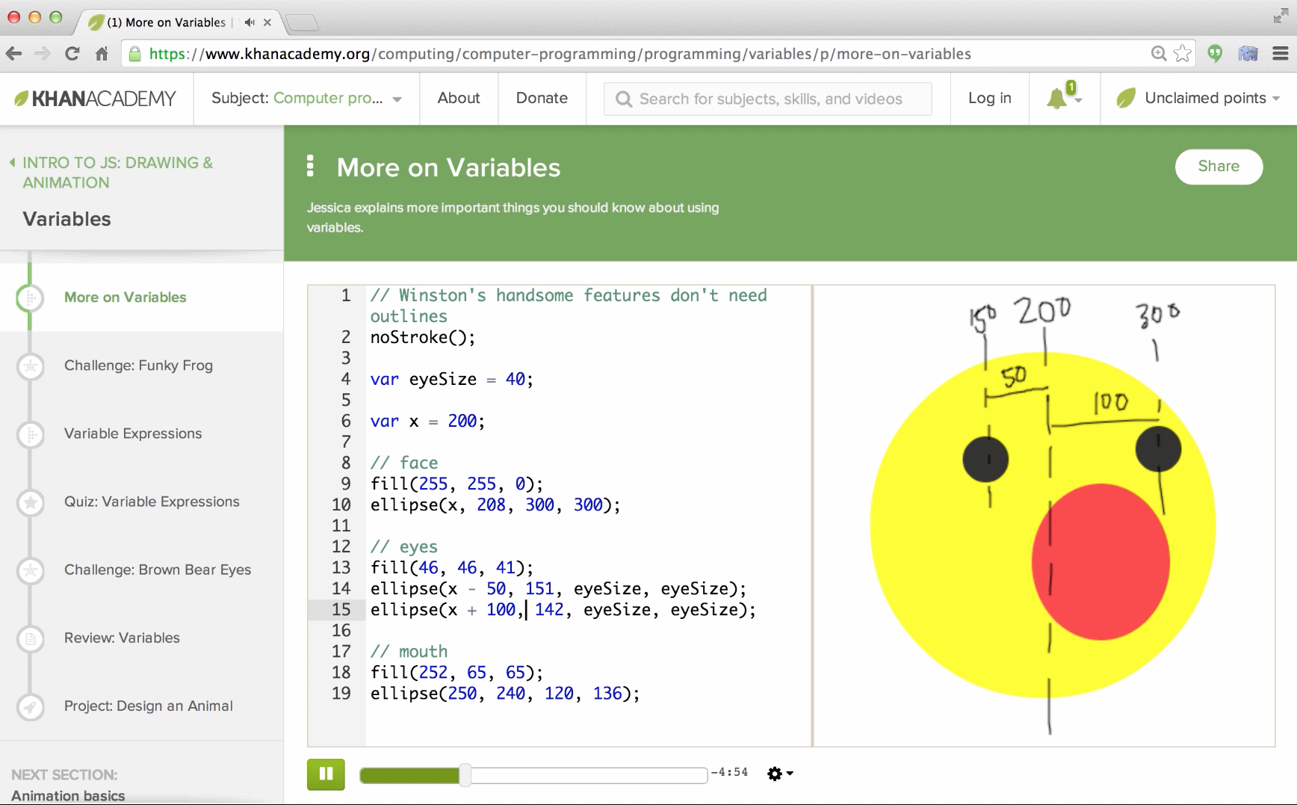
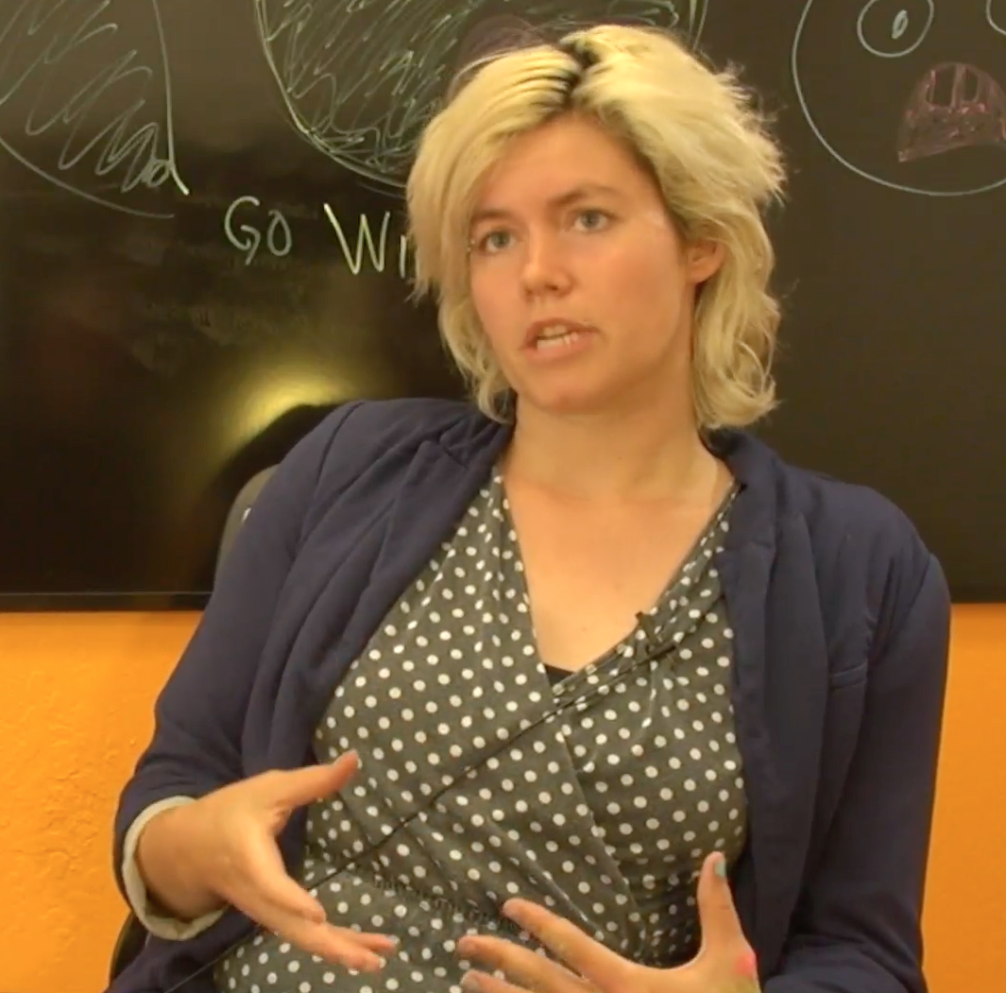
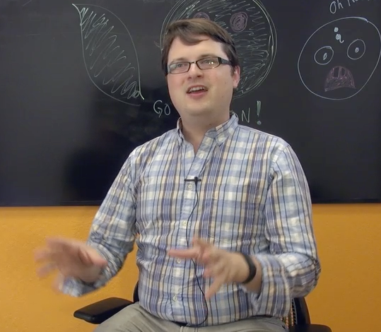
https://www.youtube.com/watch?v=veQaSgjQO2E
Pamela
Fox
John
Resig
Notes:
High School Advanced Placement thoughts.

Slide 15
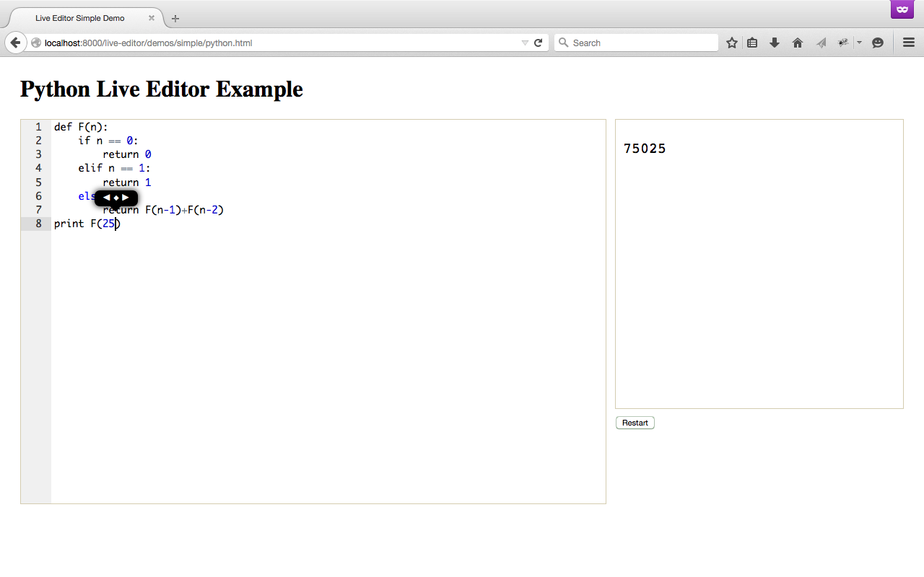
Work In Progress

Slide 16
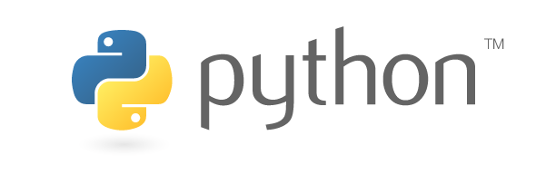
Is syntactically significant white space so inherently superior that it was inevitable that Python would become dominant as the language to engage a broad range of programmers?

Slide 17
www.pythontutor.com
Phillip Guo
University of Rochester
www.pgbovine.net
www.pythontutor.com
Python is Now the Most Popular Introductory Teaching Language at Top U.S. Universities, Philip Guo, July 7, 2014
http://cacm.acm.org/blogs/blog-cacm/176450-python-is-now-the-most-popular-introductory-teaching-language-at-top-us-universities/fulltext
Notes:
University of Rochester

Slide 18
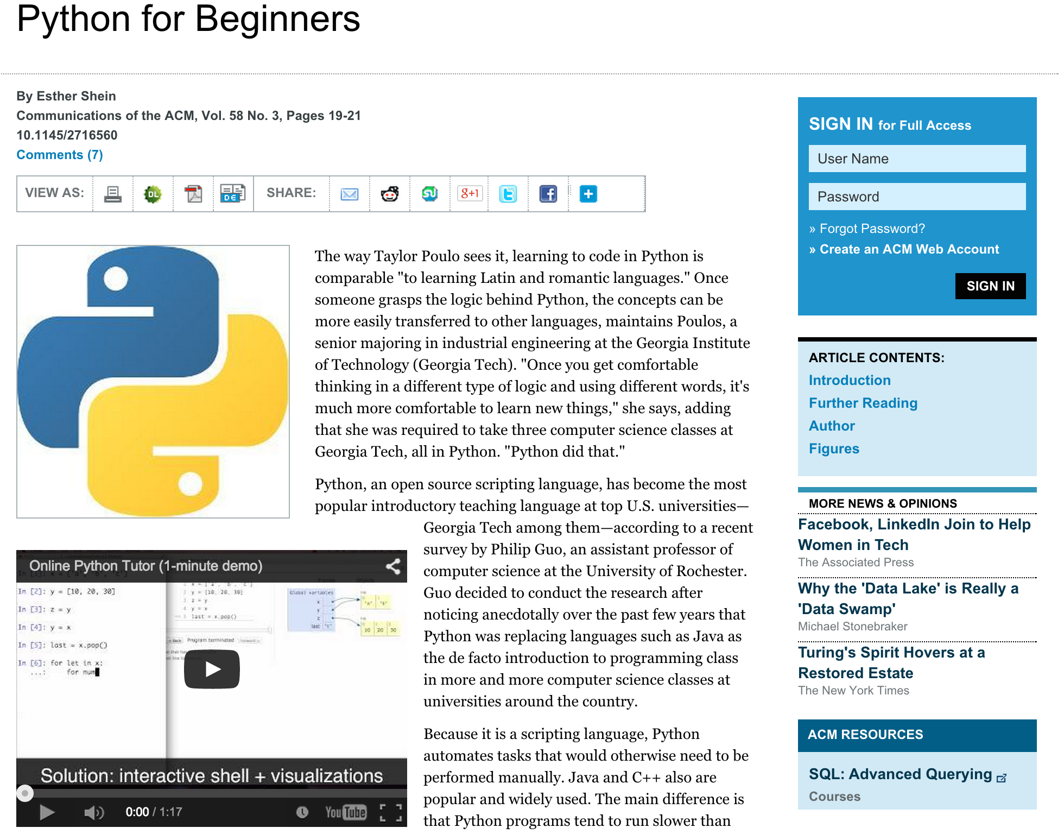
http://cacm.acm.org/magazines/2015/3/183588-python-for-beginners/fulltext
Notes:
"Python is a fad"

Slide 19
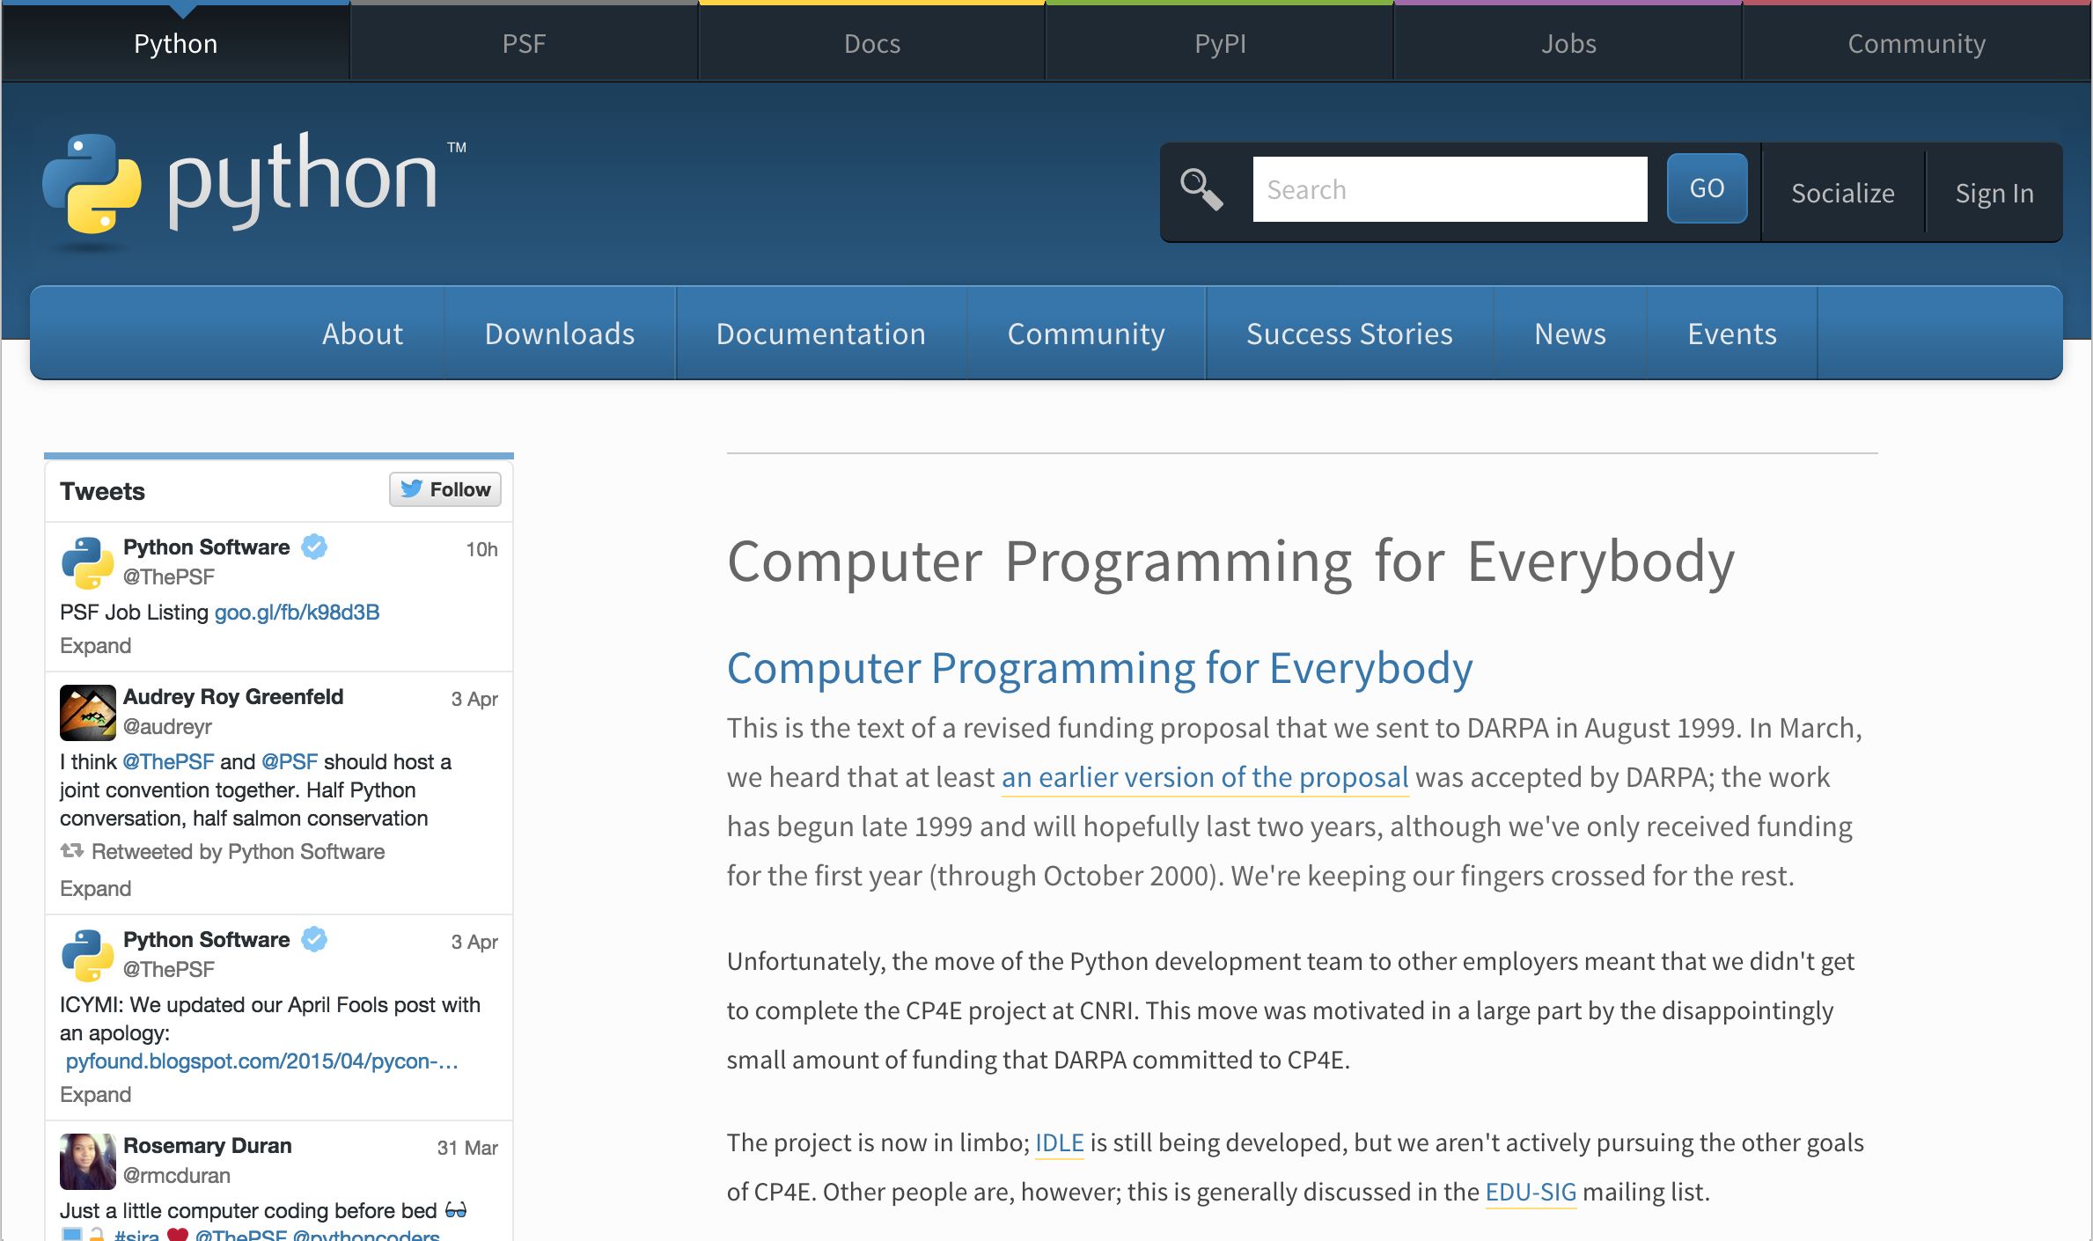
https://www.python.org/doc/essays/cp4e/
August 1999

Slide 20
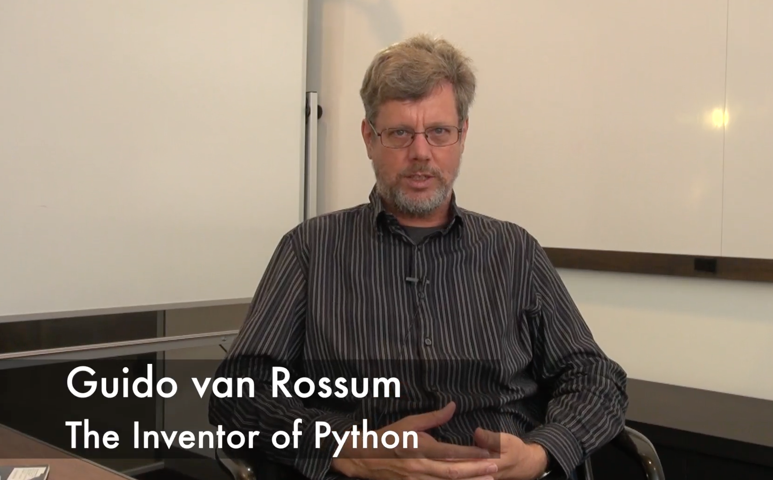
Message from Our BDFL
https://www.youtube.com/watch?v=SdH8fI1aNZA
https://www.youtube.com/watch?v=xLVxoz-mQFs
https://www.youtube.com/watch?v=rTTFh7HOlC0

Slide 21
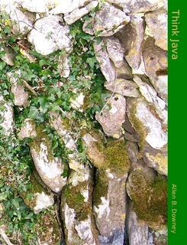
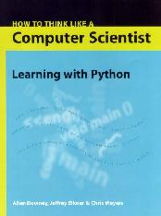
Allen B.
Downey
1999
2002
http://greenteapress.com/thinkjava/
https://sites.google.com/site/allendowney/
http://www.elkner.net/
Jeff Elkner

Slide 22
Allen B.
Downey
1999
2002
http://greenteapress.com/thinkjava/
https://sites.google.com/site/allendowney/
http://www.elkner.net/
2010
Jeff Elkner

Slide 24
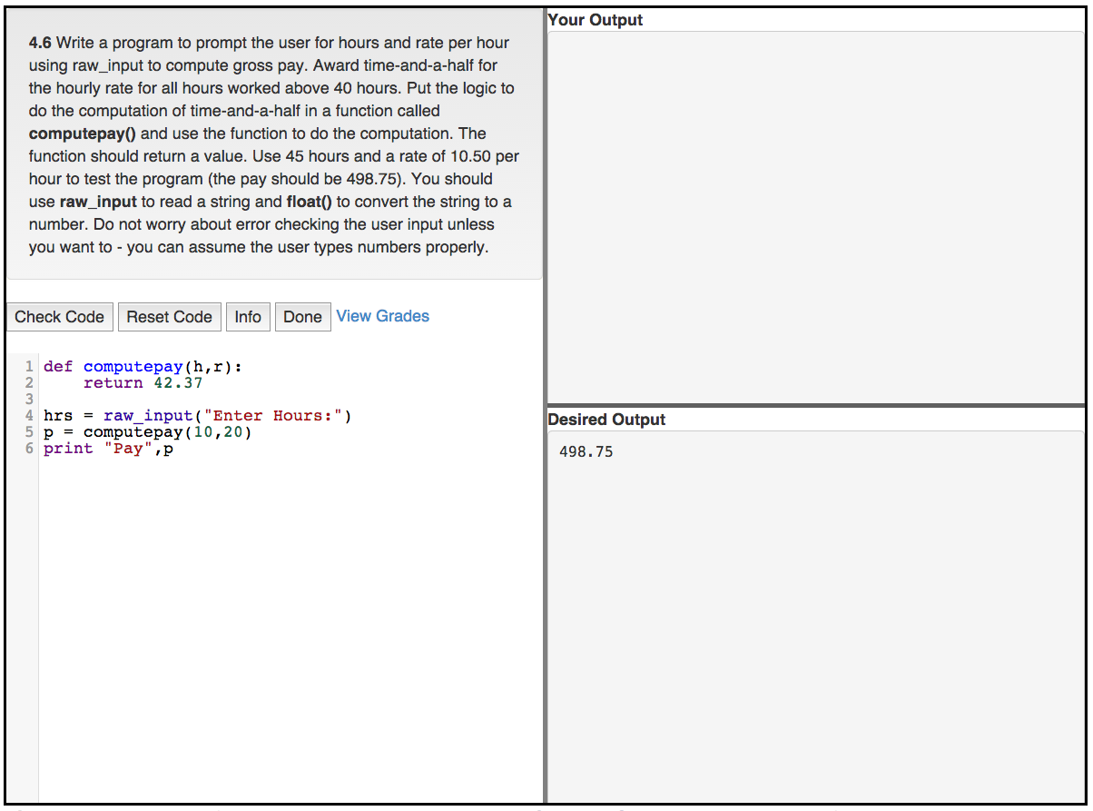
www.tsugi.org

Slide 25
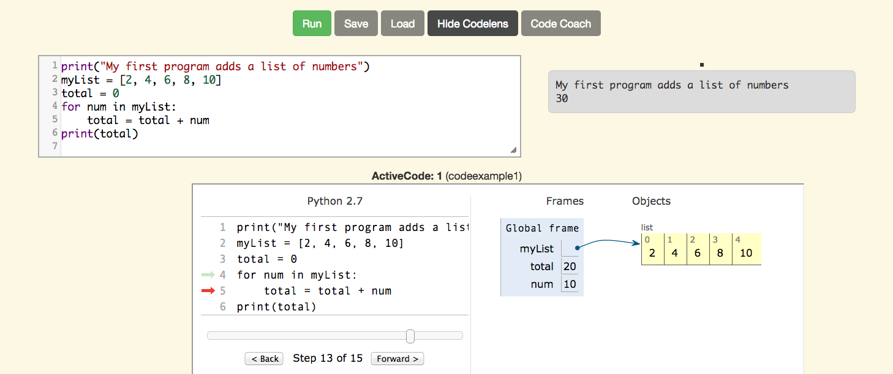
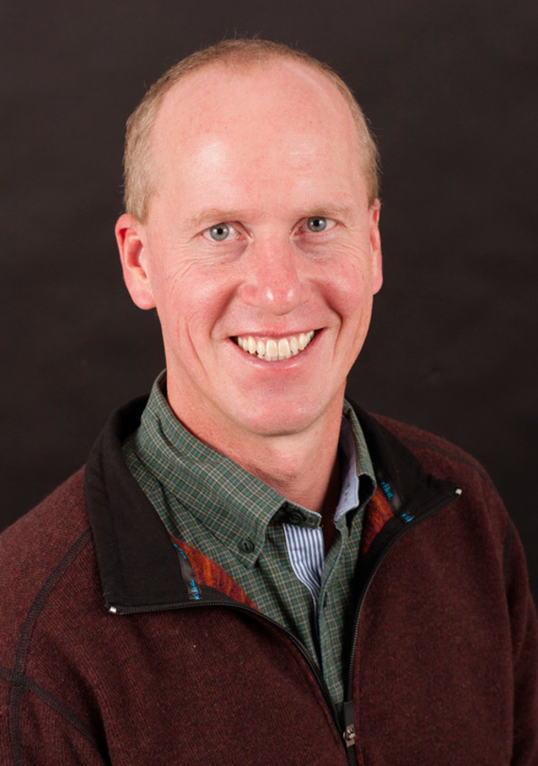
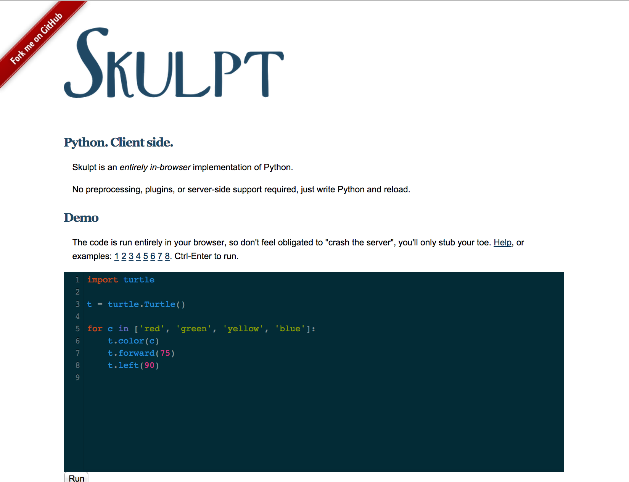
Brad
Miller
http://www.skulpt.org/
http://interactivepython.org/
https://www.luther.edu/millbr02/

Slide 26
>12 Million Students
Notes:
Top search query on Coursera is "Python" The top-10 are mostly programming related

Slide 27
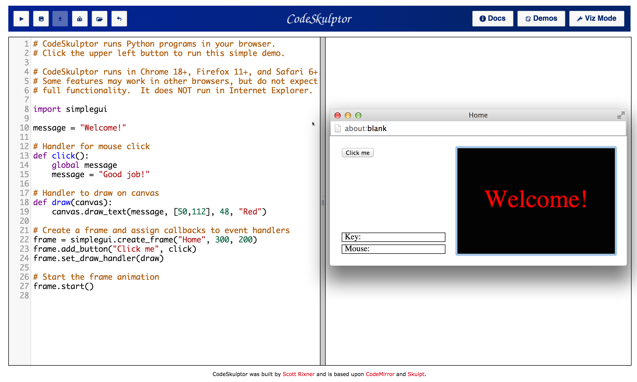
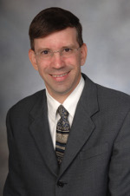
www.codeskulptor.org http://www.cs.rice.edu/~rixner/
Scott
Rixner

Slide 29
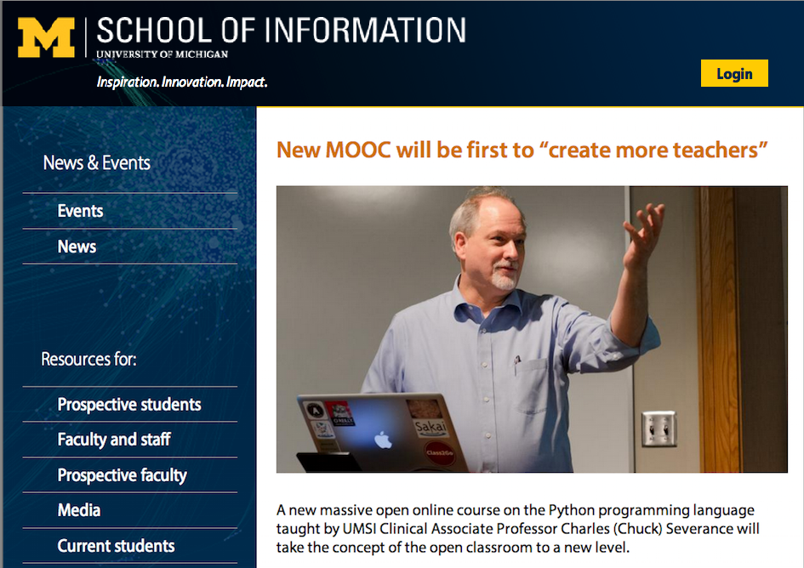

Slide 30
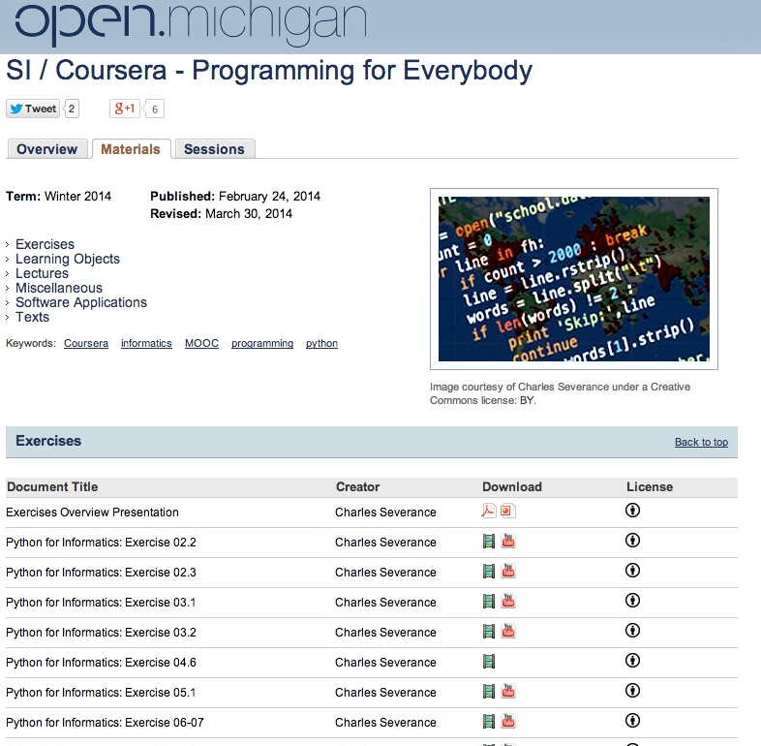

Slide 31
Freely Reusable and Re-mixable
Course Enrollment
Coursera, Dr. Chuck Online, CourseSites, CanvasNet (soon)
Statement of Accomplishment on Coursera
Badge on Dr. Chuck Online
Book: PDF, MOBI, EPUB, iBooks (CC-BY-NC*)
Lecture Slides in editable form (CC-BY)
Lecture Videos in MP4 or YouTube (CC-BY)
Auto-Grader software integrated into any LMS
* I will remove NC for a legitimate translation

Slide 32
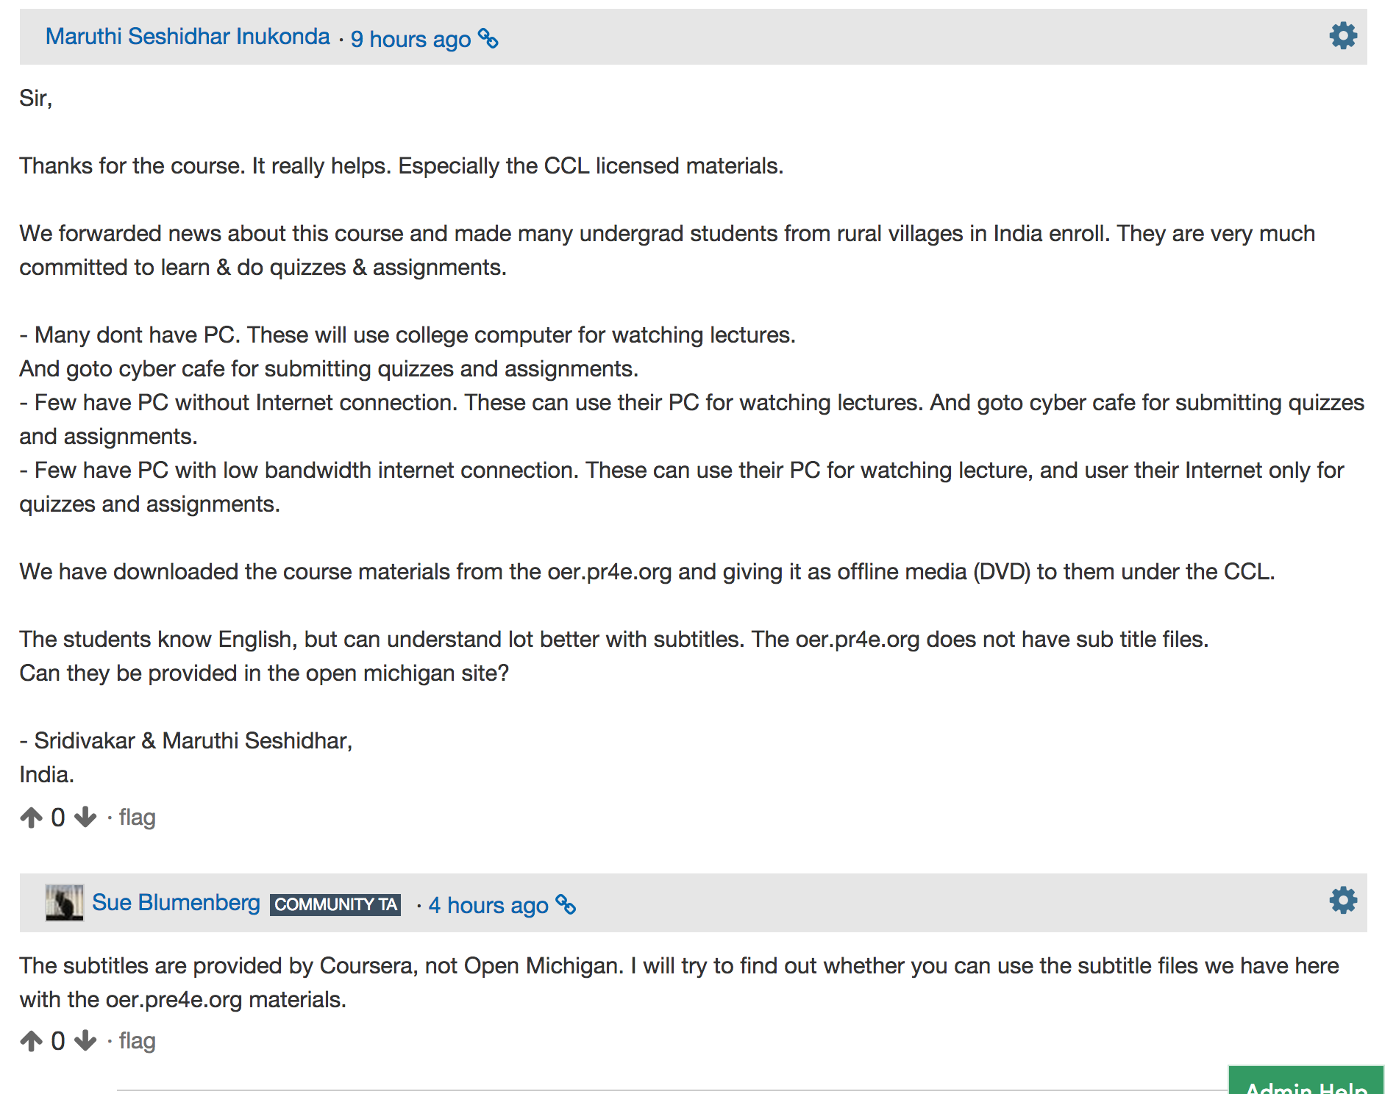

Slide 33
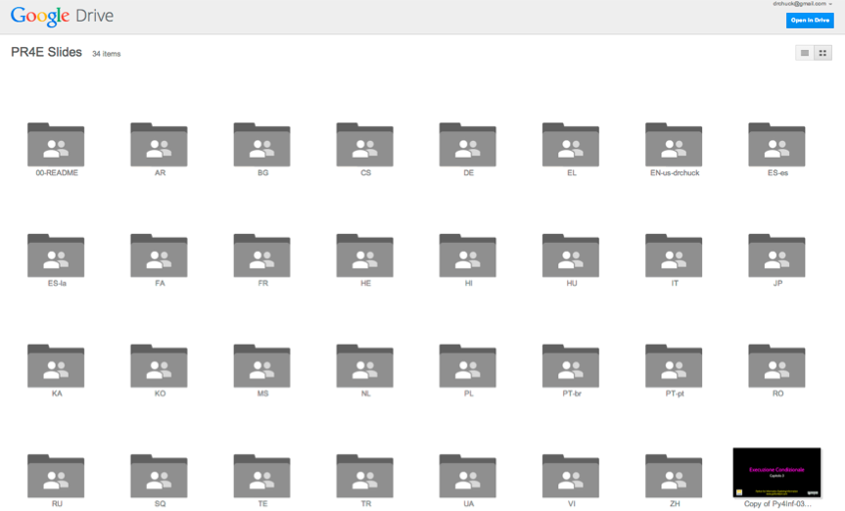
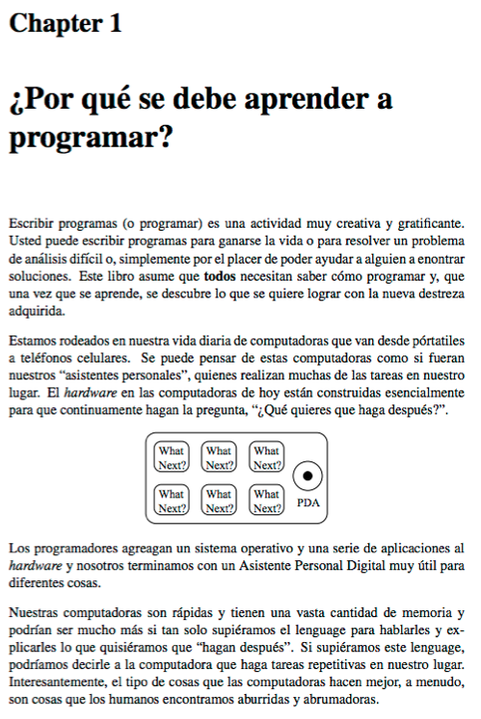
Open / Free has other advantages...
slides.pr4e.org
translate.pr4e.org

Slide 34
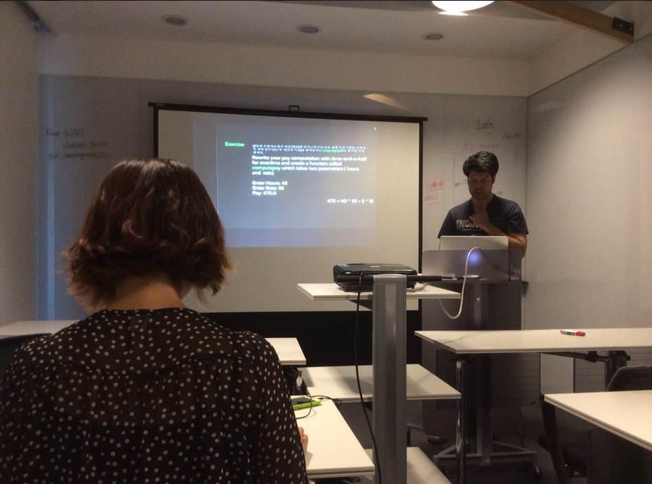
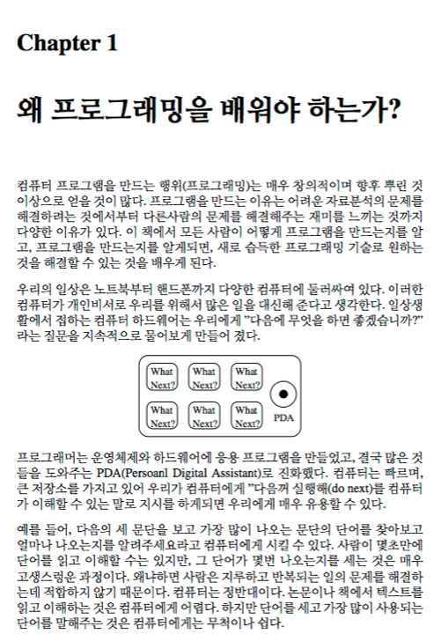
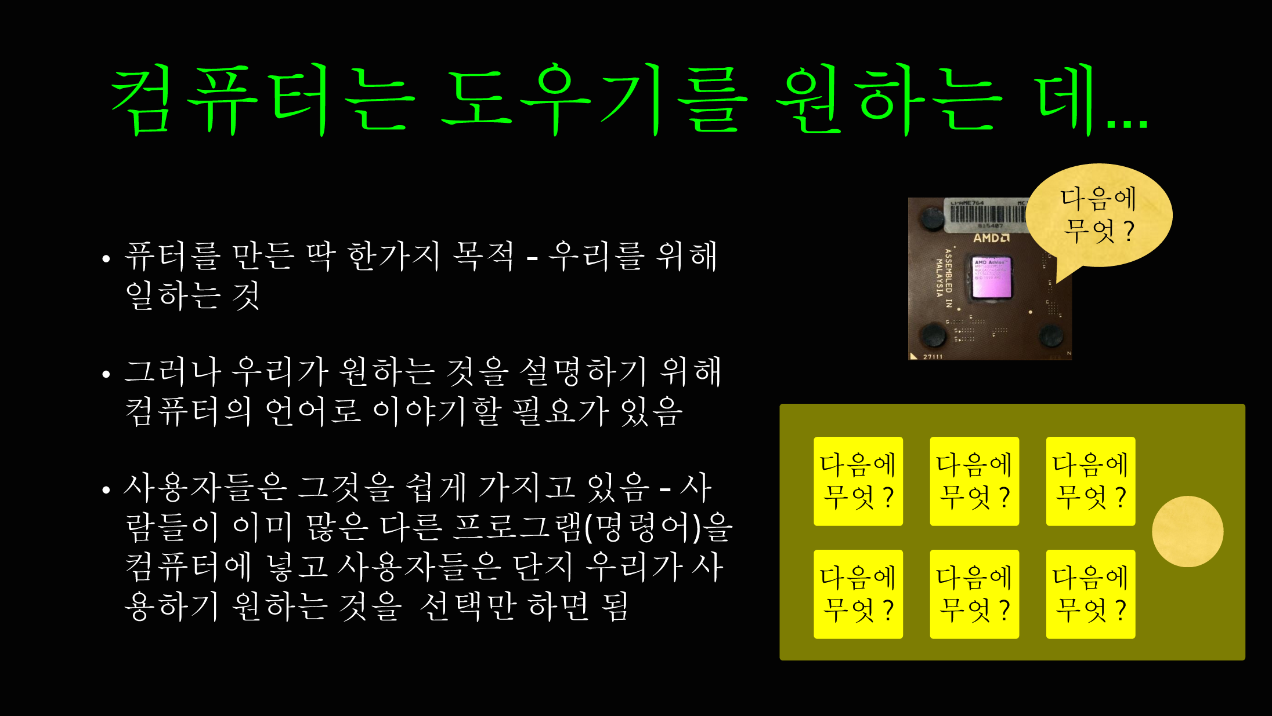
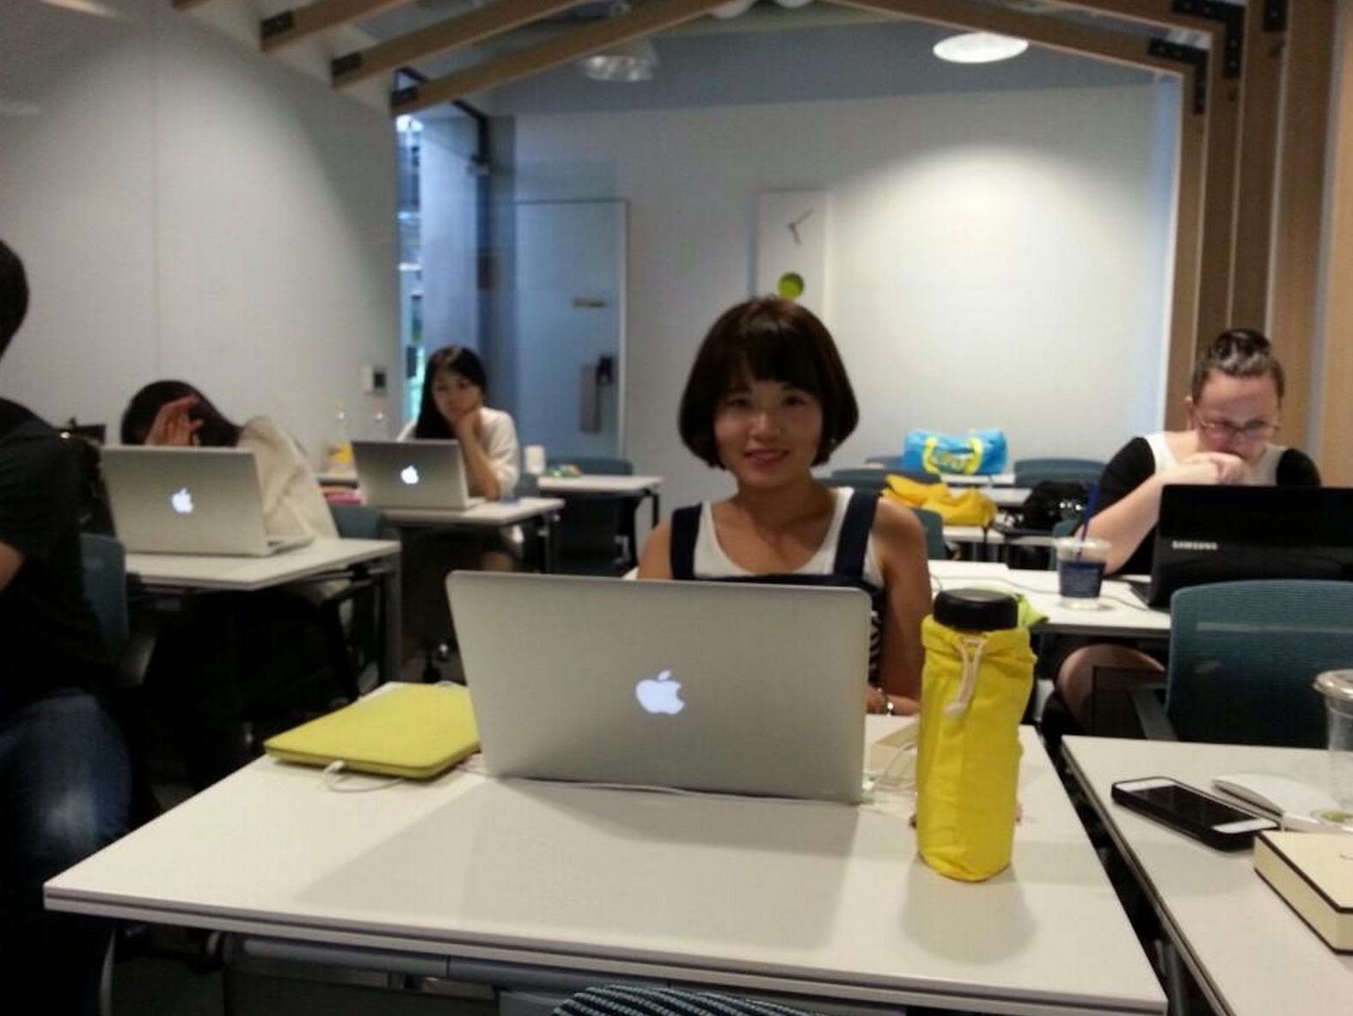
Victor KC Lee @statkclee
https://github.com/statkclee

Slide 35
If the observed effect over the past 15 years is that Python has emerged as the leading language to engage a broad range of programmers, what is the cause?

Slide 36
If the observed effect over the past 15 years is that Python has emerged as the leading language to engage a broad range of programmers, what is the cause? Is it white space?

Slide 37
